Slide 1
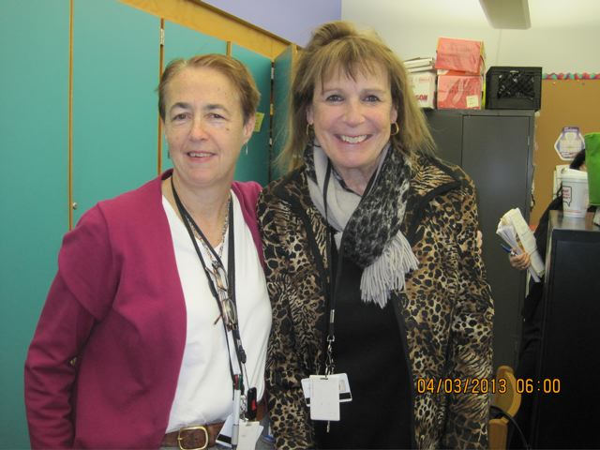
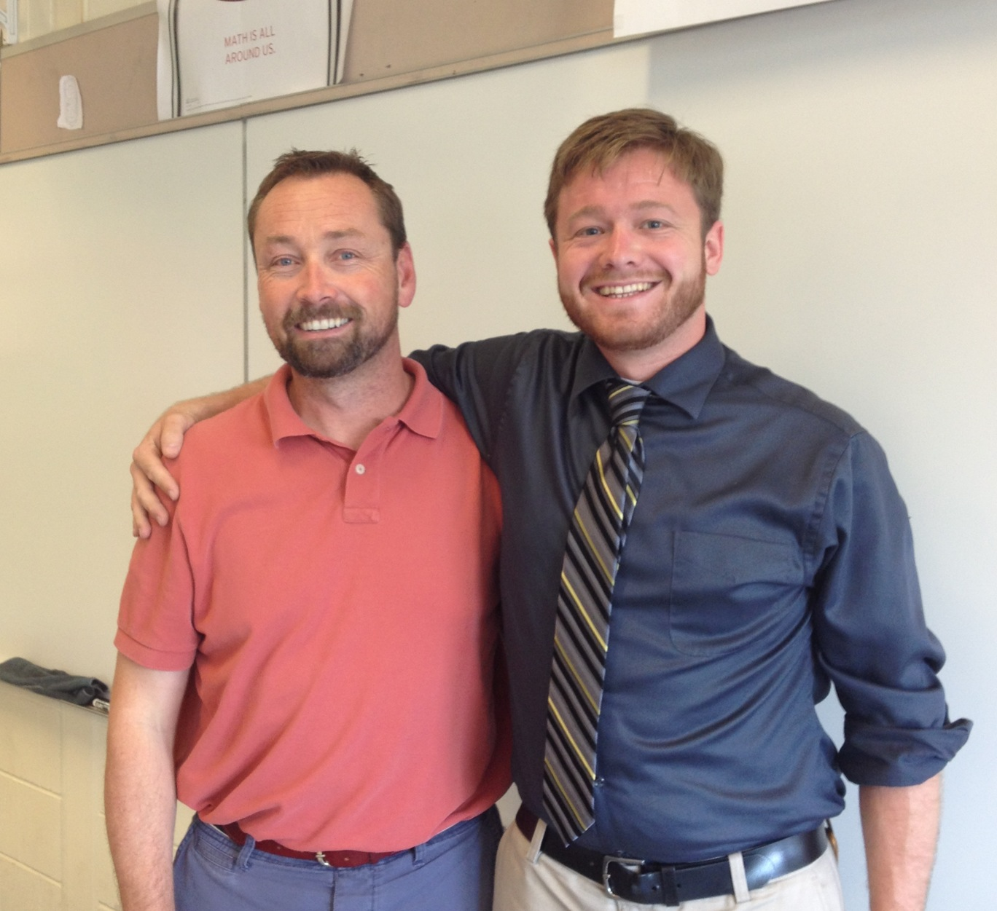
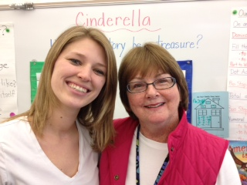
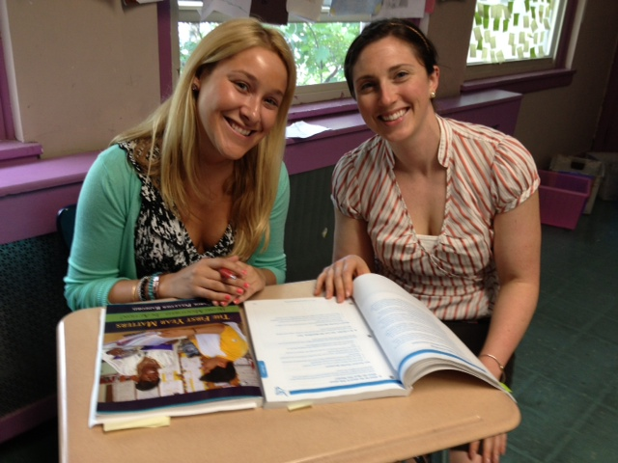
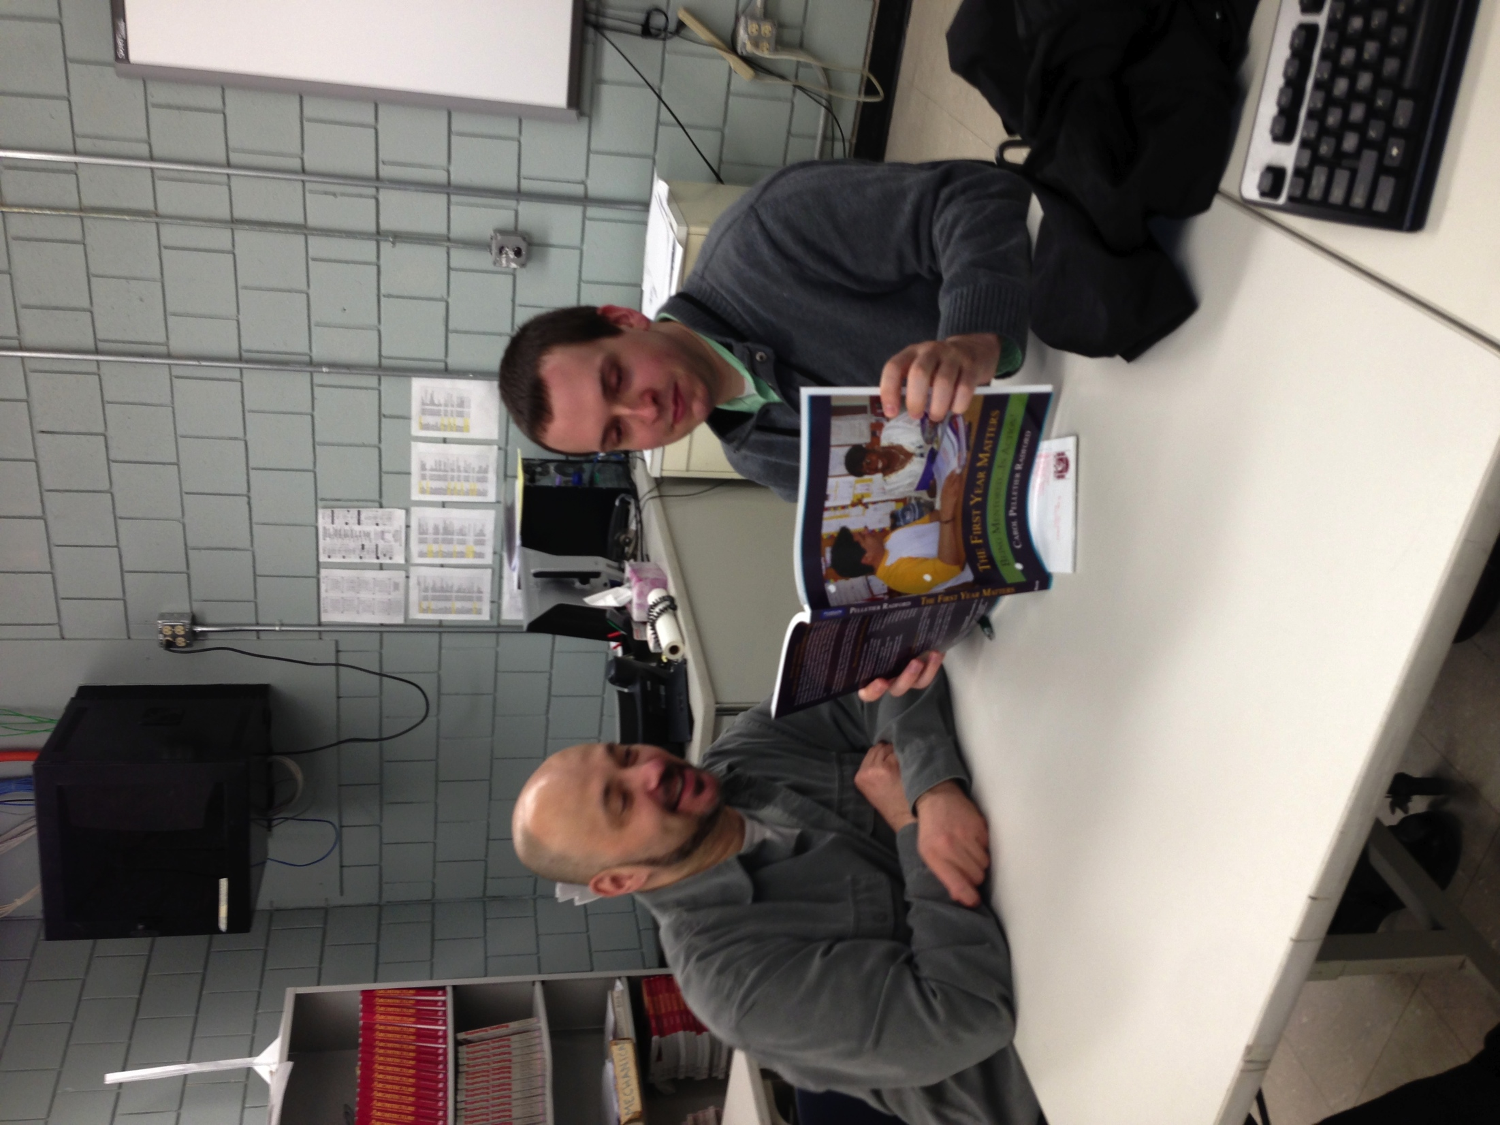
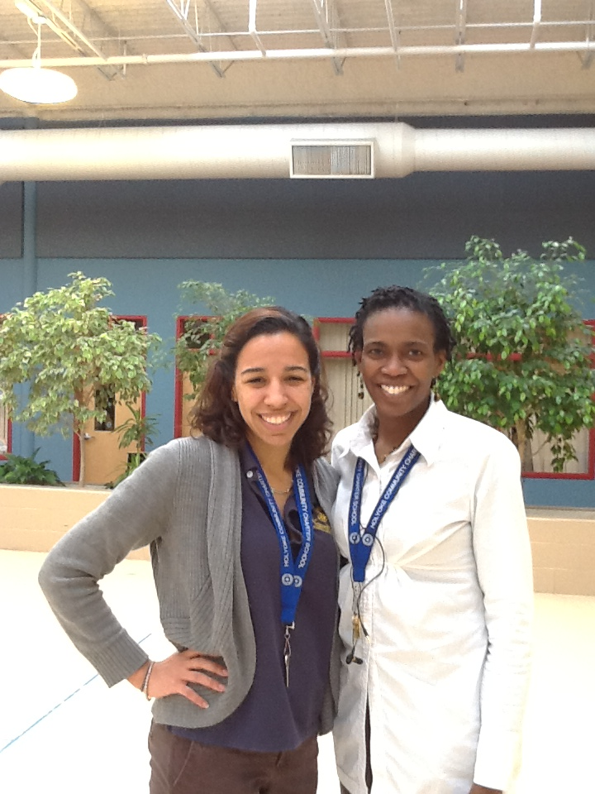
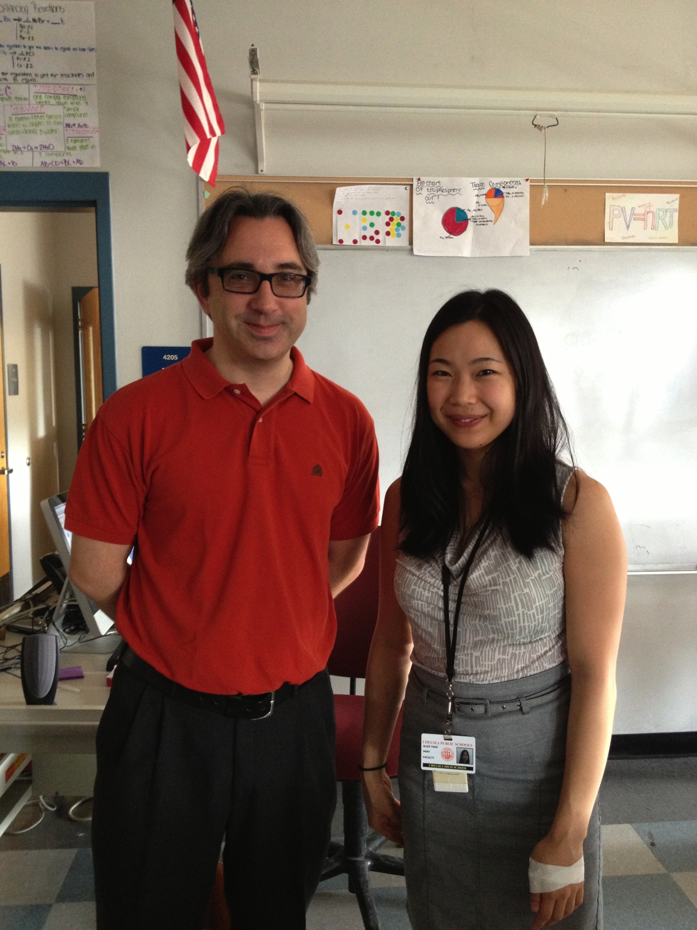
MTA Summer
Conference 2014

Slide 2
Developing Social and Emotional Awareness in All Teachers
1:45- 5:00 PM

Slide 3
Door Prize
Using one of the index cards provided, write your response to the following prompt:
What do you hope to learn in this session?
Your responses will be collected at the end and entered for a door prize!
Notes:
Carol – team hands out index cards

Slide 4
Notes:
Our purpose is to design a plan that is “sustainable” and that uses TEACHER LEADERSHIP
We want to branch out our plan to Align, Differentiate, and Impact our work in schools so Novice teachers are RETAINED and PROFICIENT!
ALIGN- to State and National Standards – the Teacher Evaluation Rubric- and your District Action Plan to maintain a common language for the novice teachers and mentors.
DIFFERENTIATE your activities for Career Changers – First Classroom teachers and NEW to the district or grade level teachers so everyone isn’t doing the same thing! Modify activities as needed!
IMPACT – Focus your activities to retain novice teachers in the district and to change your school and district culture to one that supports novice teachers! Remember the goal of mentoring is to impact STUDENT LEARNING! All of this is for students!
Go through the parts of the tree briefly highlighting the 3 key components that teacher leaders need to pay attention to in their vision and plan.
Teacher Leaders -- – are the “roots” to keep this program alive after the RTTT funds are gone. Principals and Superintendents come and go – but most often teacher leaders stay! This is an opportunity to dig deep by creating a District Action Plan that will be sustained.

Slide 5
Paradigm Shift for Mentoring – Lois Zachery
 | Used to be… | Now …
Mentee | Passive | Active
Mentor | Authority | Facilitator
Learning Process | Mentor Directed | Self Directed
 | Face-to-face | Multiple and varied (groups, skype, phone, email, on-line
Focus | Knowledge transfer and acquisition | Critical reflection and application
Notes:
Focus on novice teacher needs and involvement

Slide 6
Transform your novice teacher by recognizing the teacher’s developmental phases
3
2
Launch new teachers with professional license
MENTOR through years 1-3
First the egg – Begin with student teachers
and their cooperating teachers

Slide 7
What is Social Emotional Learning?

Slide 8
Qualities of Effective Teachers Through Students’ Eyes

Slide 9
Three Practical Strategies
1
2
Sharing Best Practices
Integrating Student Perspectives Using Surveys
Problems to Possibilities
3

Slide 10
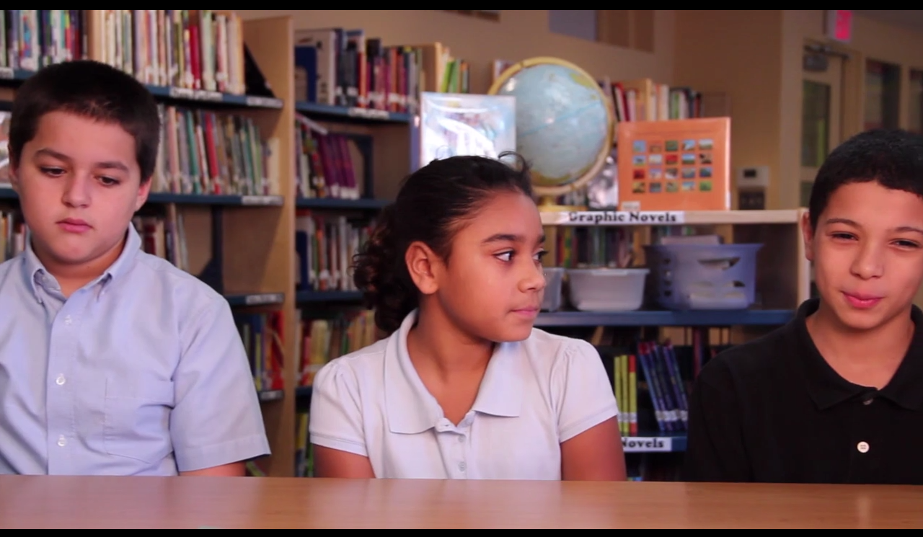
Strategy 1
Integrating Student Voices into Mentoring Conversations

Slide 11
Using Online Surveys for Middle and High School Students

Slide 13
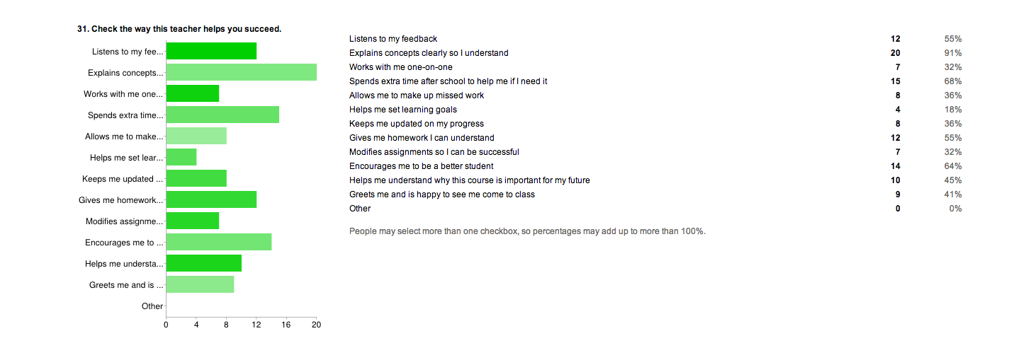
Online Survey Feedback

Slide 14
Online Survey Feedback
“She helps me when I don’t know what to do. I know I can talk to her if I need to.”

Slide 15
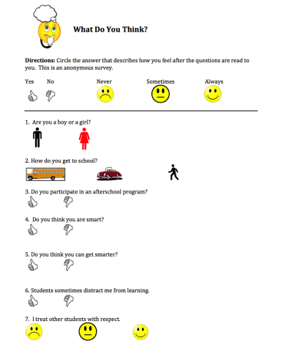
Elementary Survey
Notes:
Cindy will explain how the survey was developed and why the questions were included. How it was delivered to students.

Slide 17
What We Learned About Anonymous Surveys
Teachers’ confidence increased based on responses from students when it indicated proficiency
Notes:
Shonna

Slide 18
What We Learned About Anonymous Surveys
Feedback from the students motivated teachers to reflect and change their practices!
Notes:
Shonna

Slide 19
What We Learned About Anonymous Surveys
The data yielded by the student surveys provides information that the teacher would otherwise not be able to access
Notes:
Cindy

Slide 20
How would you use Student Surveys in your context?
Notes
Strategy 1

Slide 21
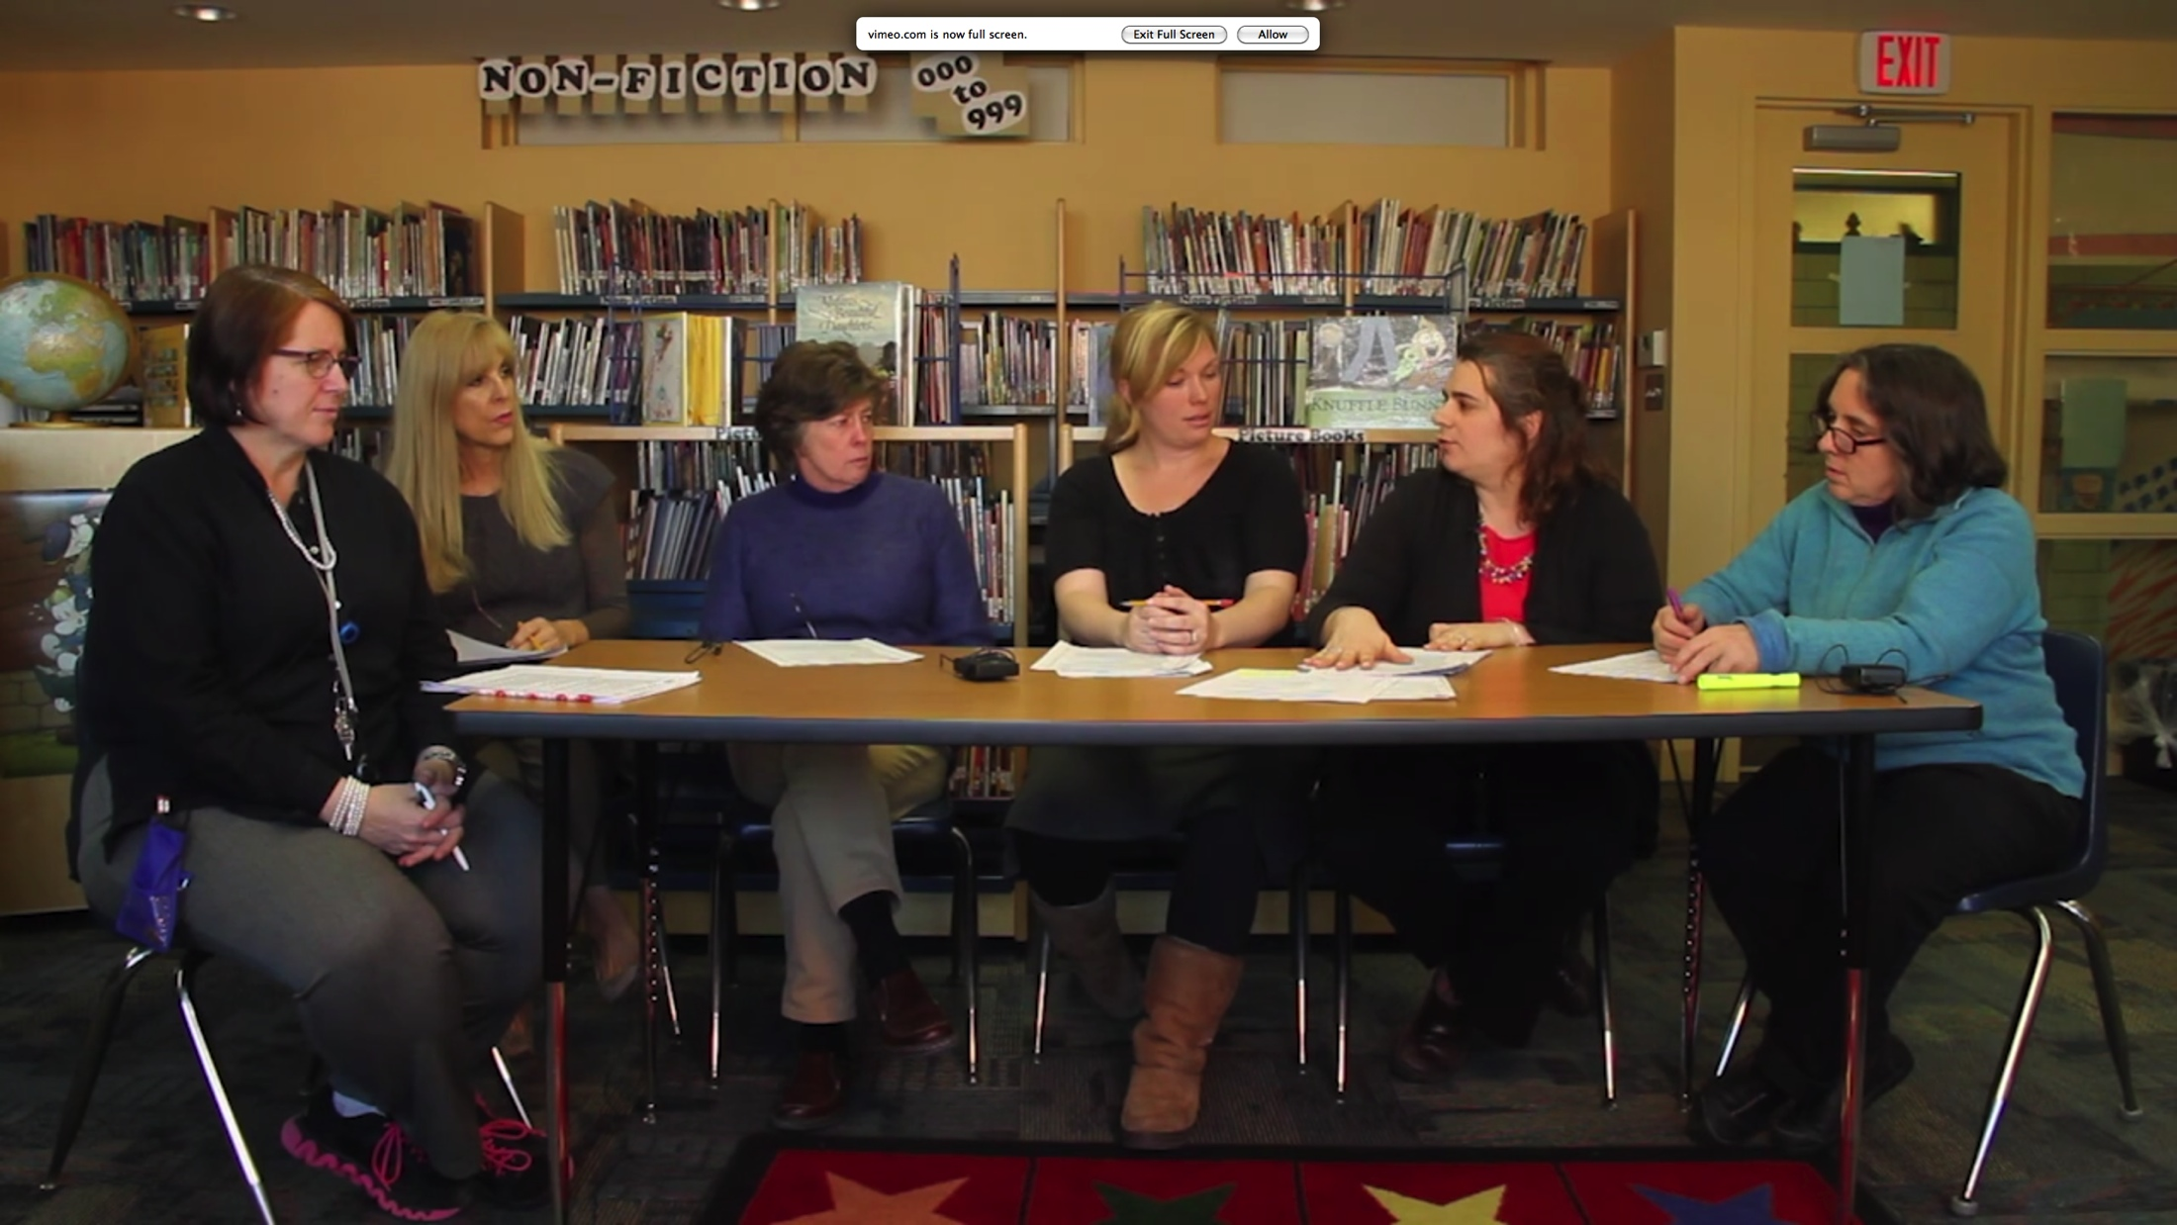
Strategy 2
Mentor Led
Problem-Solving Groups
Notes:
Stephanie – overview of the process

Slide 22
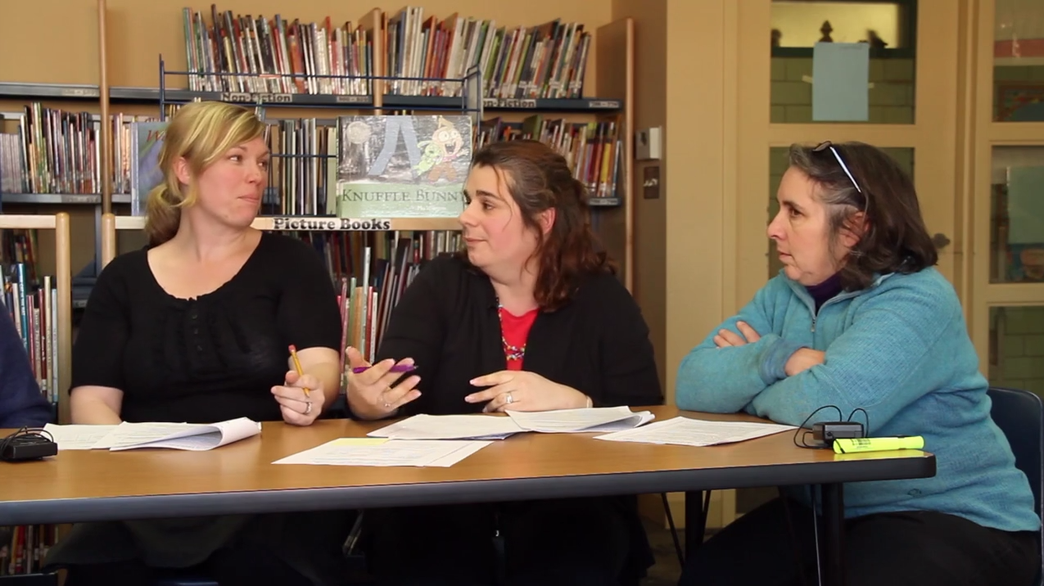
Problems to Possibilities
Notes:
Focus on Solutions… in this group not what isn’t working!
Stephanie talks while this slide is up – overview of why this group was designed and how she created the agenda

Slide 23
Notes:
Stephanie Introduces the video a bit – what are people going to see in this video.

Slide 24
How would you use “Problem Solving” Group Mentoring in your context?
Notes
Strategy 2

Slide 25
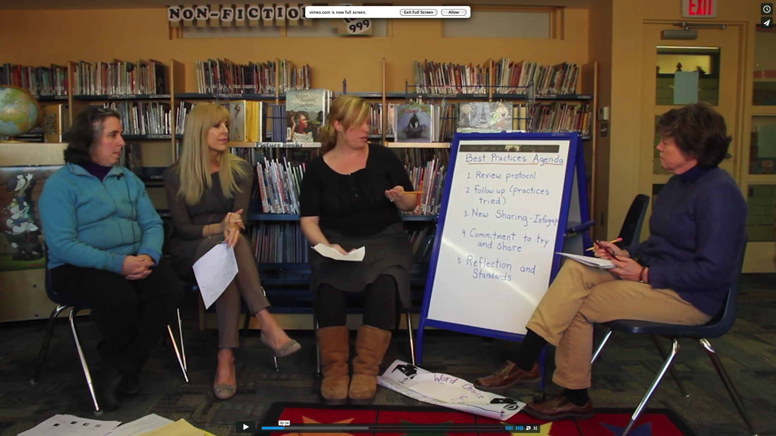
Strategy 3
Novice Teachers as Emerging Leaders: Sharing Best Practices
Notes:
Edna introduces the process and why this group is different from the problem solving group.

Slide 26
Notes:
Edna introduces what audience is going to view.

Slide 27
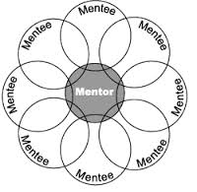
How can we use group mentoring in our District Plan?
Meeting the 50 hour requirement in years 2 and 3!
Supporting novice teacher leaders in years 1-3!
Establishing problem solving groups in years 1-3!

Slide 28
How would you use Sharing Best Practices in your context?
Notes
Strategy 3

Slide 29
INSIGHT #1
When teachers discuss anonymous student perspectives using a protocol they can immediately change their practices to become more effective teachers
Notes:
Cindy

Slide 30
INSIGHT #2
When teachers experience social emotional learning in problem solving groups they become less anxious and respond to their students in an emotionally balanced way.
Notes:
Stephanie

Slide 31
INSIGHT #3
When novice teachers share best practices with each other, leading their own groups, they experience confidence in their teaching practices and learn how to be colleagues.
Notes:
Edna

Slide 32
Bubble Reflections Classroom Management pages Aligment to Teacher Evaluation
Mentoring in Action – A Resource for you to use!

Slide 33
Notes:
Closing Slide
Videos are there now and more in the future…

Slide 34
REFLECT…
WRITE… DISCUSS…
What are you hearing?
How do these strategies and resources relate to your work?
How can this information be helpful to you?

Slide 35
What Will You Do?
Awareness
Self Awareness
Self Management
Social Awareness with Colleagues
Social Awareness with Students
Developing Social Emotional Awareness
Sharing SEL competencies and resources
Including student perspectives
Group mentoring
Helping others become more aware of SEL
Notes:
Carol

Slide 36
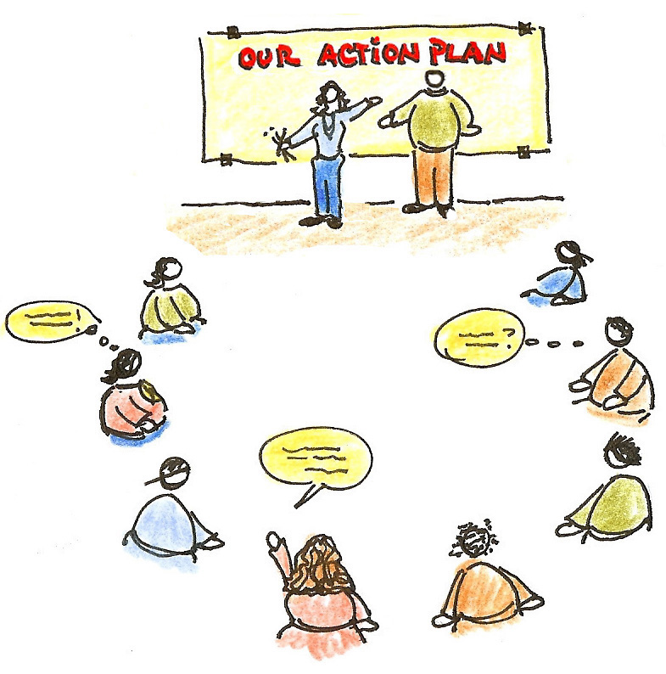
Developing an action plan

Slide 37
Vision to ACTION!
More effective teaching in all classrooms
Creating a common language and plan
Individual Action Plan Reflection
Meeting the emotional needs of all teachers and students
District Action Plan – Team Collaborating

Slide 38
“Social emotional learning is not something else on your plate. It is the plate.”
-Dr. Ed Dunkeblau, Director Institute for Emotionally Intelligent Learning

Slide 39
What did you learn from this session that you will ripple out to others? Who is the Door prize winner?
Notes:
Train the trainer – ripples out

